Slide 1


Slide 2
What is Design Pattern ?
How Many Design patterns are there ?
Which design pattern I have to use in my project ?
Mastering C# Design patterns

Slide 3

C# Design Patterns
Maruti Makwana
M C T Corporate Trainer

Slide 4
What is Design Pattern ?
How Many Design patterns are there ?
Which design pattern I have to use in my project ?
C# Design Patterns

Slide 5
Which tools are Required ?
Visual Studio 2013
Hands ON

Slide 6
There are 3 types of design patterns
GOF Design patterns

Slide 7
Creational Design Patterns
These patterns deal with the process of objects creation in such a way that they can be decoupled from their implementing system.
This provides more flexibility in deciding which objects need to be created for a given use case/ scenario.
Structural Design Patterns
These patterns deal with the composition of objects structures.
The concept of inheritance is used to compose interfaces and define various ways to compose objects for obtaining new functionalities.

Slide 8
Behavioral Design Patterns
These patterns deal with the process of communication, managing relationships, and responsibilities between objects.
Creational
Structural
Behavioral
Factory
Abs Factory
Builder
Prototype
Singleton
Adaptor
Bridge
Composite
Decorator
Façade
Flyweight
Proxy
Chain of Resp..
Command
Iterator
Interpreter
Mediator
Observer
Momento
State
Visitor
Strategy

Slide 9
Behavioral Design Patterns
These patterns deal with the process of communication, managing relationships, and responsibilities between objects.
Creational
Structural
Behavioral
Factory
Abs Factory
Builder
Prototype
Singleton
Adaptor
Bridge
Composite
Decorator
Façade
Flyweight
Proxy
Chain of Resp..
Command
Iterator
Interpreter
Mediator
Observer
Momento
State
Visitor
Strategy
Repo

Slide 10
C# Programming

Slide 11


Slide 12
C# Programming

Slide 13
How many instance of an abstract class we can create ?
None
One
non abstract methods
Abstract class can have
both
abstract methods
private
Abstract methods should be
public

Slide 14
Yes
An abstract class can be sealed
No
Yes
An abstract class can static
No
What is abstract Class ?

Slide 15
Abstract Class
What is an Abstract Class?
Word “Abstract” means “IDEA”
An abstract class is a special kind of class that has no implementation. It cannot be instantiated. Its implementation logic is provided by the classes that derive from it.
It can have both abstract as well as non-abstract methods.
With an Abstract Class, we can provide some kind of default functionality for all derived classes to extend from. This is useful to avoid code duplication in many cases.

Slide 16
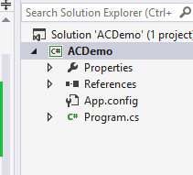
Create new console application

Slide 17
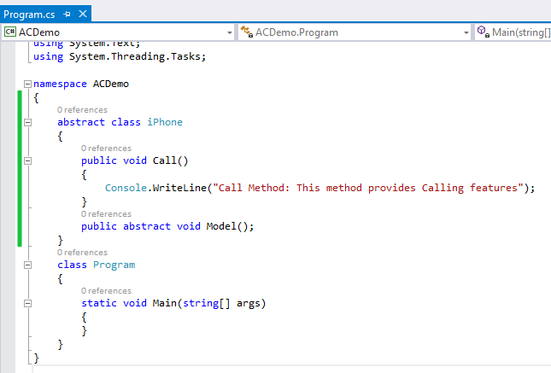
One abstract and
One non-abstract member

Slide 18
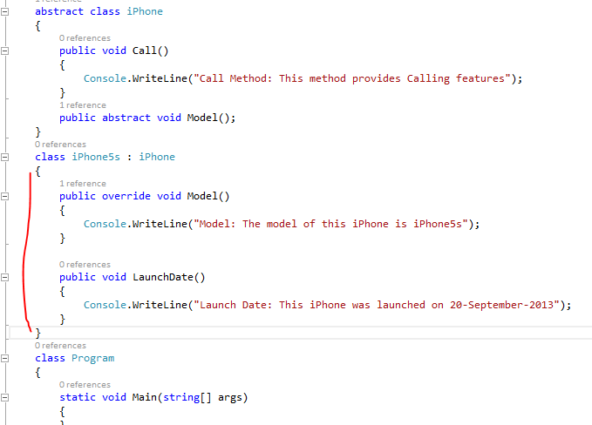
iPhone5s class has method from the abstract class as well as its own method

Slide 19
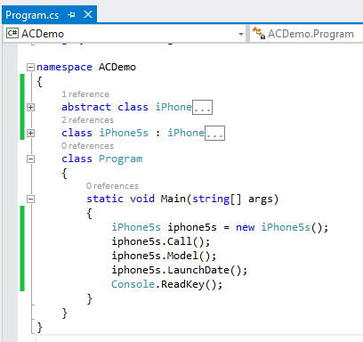

Slide 20
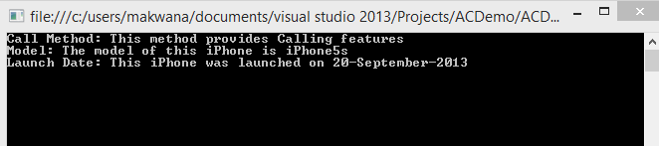

Slide 21
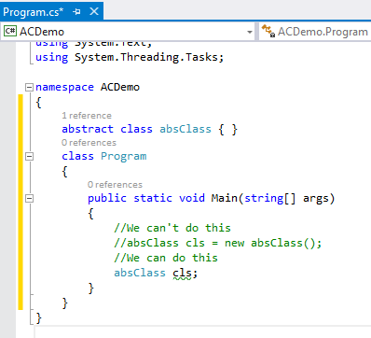
We cannot create an object of Abstract Class but
we can create a reference of it.

Slide 22
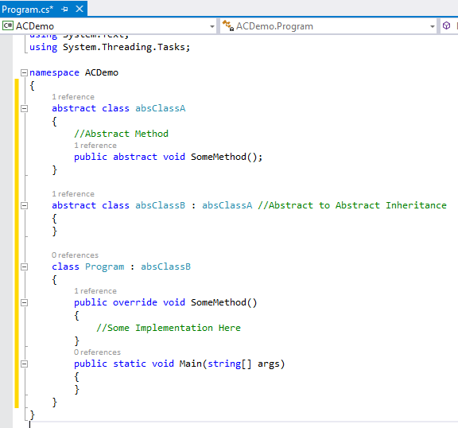
An inheritance between abstract to abstract classes is possible. We don't need to implement abstract methods of the base abstract class into a derived abstract class. We can implement it later in concrete classes.

Slide 23
Some More Notes
The abstract keyword can be used with class, methods, properties, indexers and events.
Abstract members can only be declared inside an abstract class.
An abstract member cannot be static or private.
An abstract method cannot be marked virtual.
A concrete class cannot inherit more than one abstract class, in other words multiple Inheritance is not possible.

Slide 25
Interface
What an interface is
In the real world, an interface means a medium to interact with something.
Similarly, in the programming world, an interface means a contract to interact with multiple code modules.
If a class wants to communicate with an interface, it must implement it and define its members.
It has no implementation of its own and can only be implemented by a class or a struct. Any of the two that implement the interface must provide the definitions to members specified in the interface. It is like a contract for all the derived classes to follow.

Slide 26
An interface cannot contain fields, constant members, constructors, destructors and static members
An interface is not a class. It contains only method signatures. It has no implementation on its own and cannot be instantiated. Its implementation logic is provided by the classes that derived from it.
An interface is mostly considered to be a pure abstract class. However, there is the advantage of using an interface over an abstract class; that is "Multiple Inheritance Support". In C#, two classes (either abstract or concrete) cannot be inherited by the same derived class. It causes ambiguity in the derived class if both have the same method signature. But we can do multiple inheritance in C# using interfaces.

Slide 27
An interface plays a vital role in the Service Oriented Architecture (SOA).
In WCF, we use interfaces to define Service Contracts. A single class can implement any number of Service Contract Interfaces.
It is generally accepted as the best practice to do so. However, we can also use classes for Service Contracts

Slide 28
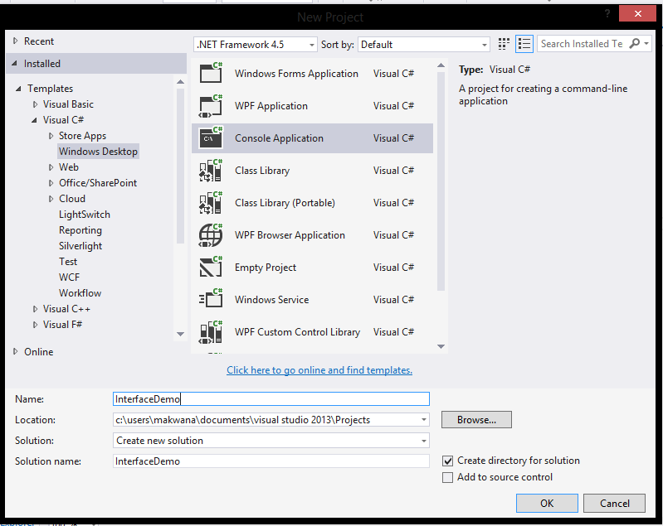

Slide 29
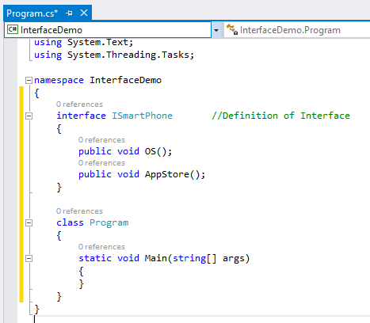
Can you spot
What’s wrong in this code ?

Slide 30
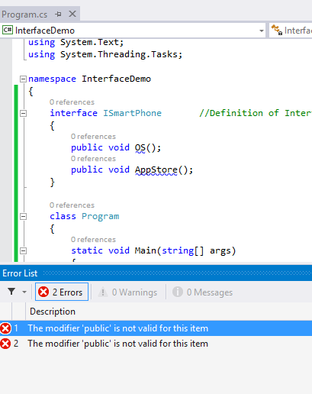
Interface methods are implicitly public in C# because an interface is a contract meant to be used by other classes. Moreover, we must declare these methods as public in derived classes, when we provide implementations to these methods. Also, we cannot declare these methods as static

Slide 31
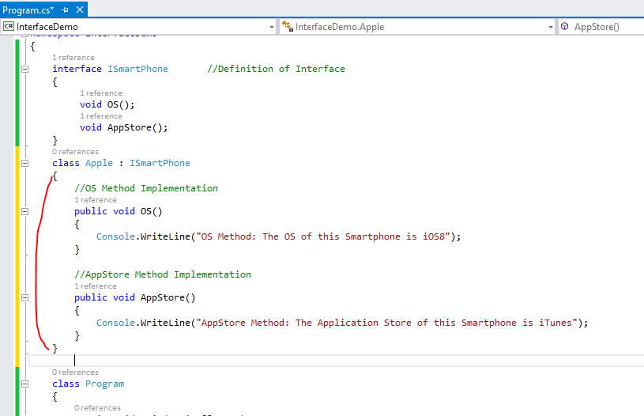

Slide 32
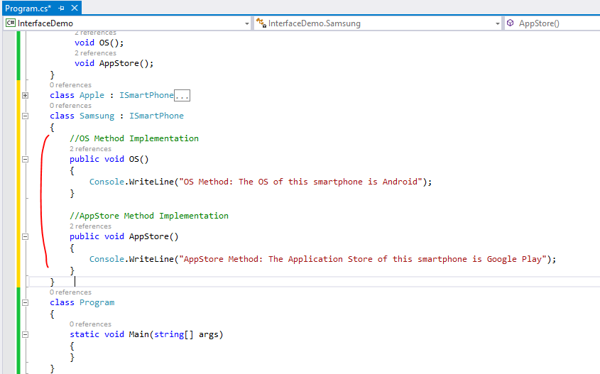

Slide 33
Now Suppose if the Apple class wants to add some new features like TouchID and Samsung don’t want it then we can implement TouchID features in Apple only and it can easily be done by defining another interface IFeatures.

Slide 34
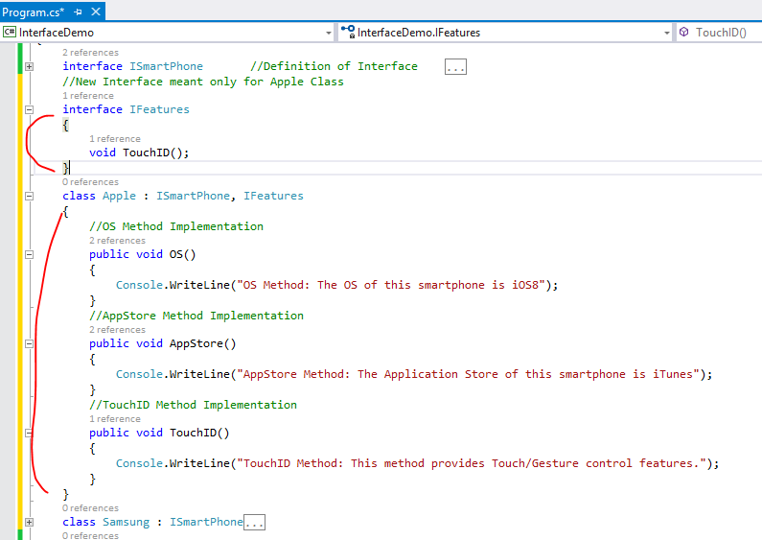

Slide 35
So, this way we can get multiple inheritance in C#. Let's create the objects of the concrete classes Apple and Samsung and build the project.

Slide 36
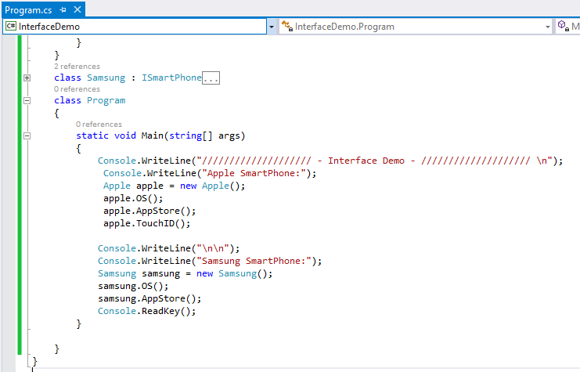

Slide 37
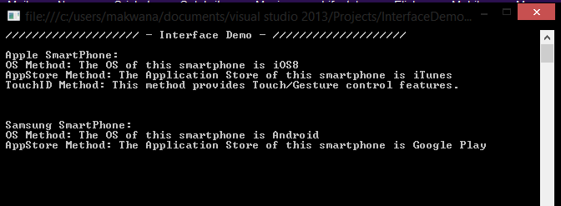

Slide 38
Explicit Interface Implementation
When working with interfaces, there occurs a situation when a class implements two interfaces and both the interfaces contain a member with the same signature. When the class provides a definition to interface members, it gets confused about which member gets the definition since both have the same name. In that case, we'll an Explicit Interface Implementation.

Slide 39
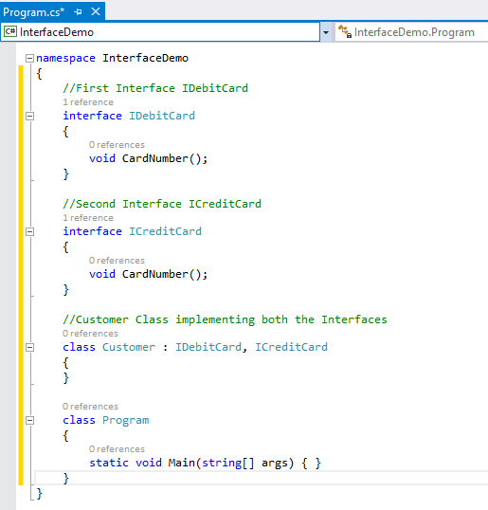

Slide 40
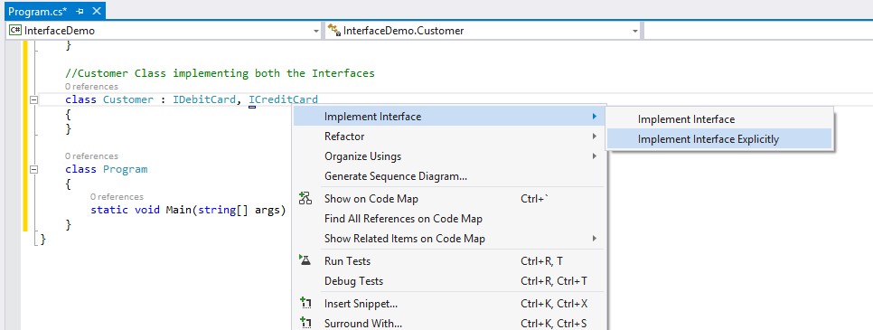

Slide 41
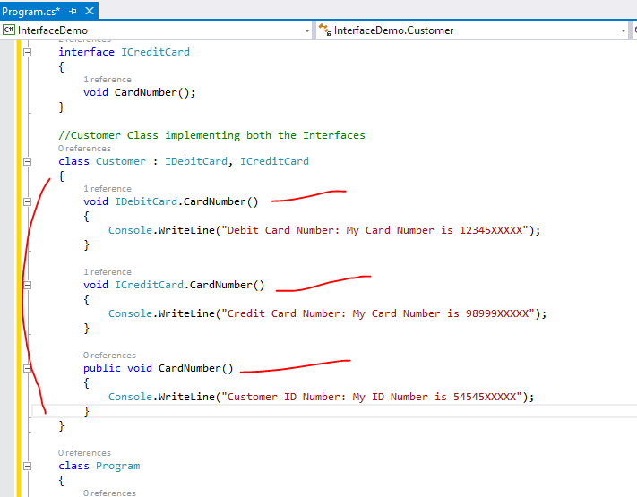

Slide 42
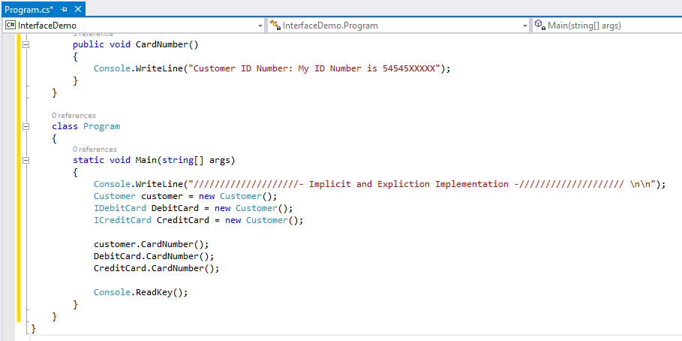

Slide 43
